Slide 1



Institute of Technology of Cambodia
Topic : Library Tracking System
Lecture: Roeun Pacharoth

Slide 2




Our Team
ROM Tola
SOKHOM Panha
PRAVE Vinuth
SRENG Panha
Project manager
Menber
Member
Member

Slide 3

Table Content
Introduction
01
Project Planing
02
Technologies & Tools
03
Architecture
04
Task Division
05
Database Design
06
UML Design
07
API Endpoint Design
08
Implementation
09
Demonstration
10
Conclusion
11

Slide 4
Introduction
Project Overview
This project is a Library Tracking System built using Spring Boot to manage books, members, and borrowing activities.
Security and Authentication Lead – Handles login, roles.
Handles main entity CRUD
Handles secondary module CRUD.
Frontend/Thymeleaf: Templates, access control.
Database

Slide 5
Introduction
Project Objective
This project build especially for librarians and library members to keep track on borrow record. Librarians can manage member, books and borrow record. Meanwhile, members can only view their borrow recorder.

Slide 6
Project Planing
Requirement Analysis
Identify Role
Define core features
System Design
Designing Database Schema
Designing UI

Slide 7







Technologies & Tools

Slide 8
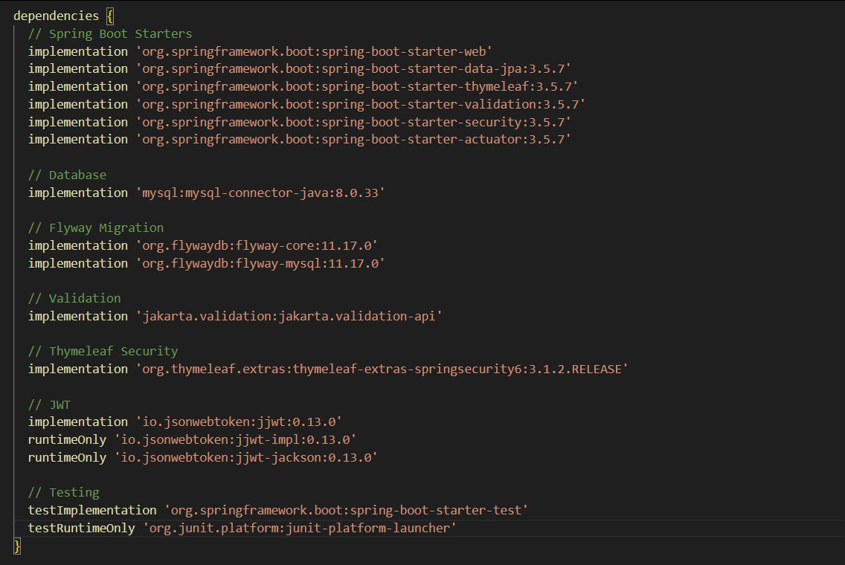
Technologies & Tools
Dependencies

Slide 9
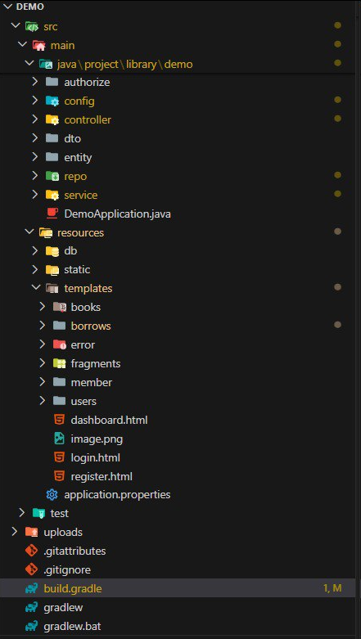
Architecture
Folder Struture
Java package
Databases file
Front-end (UI)
Spring Boot configuration
Build Files

Slide 10
Architecture
Design Workflow
Planning
Database
CRUD
AUTH
Frontend
Testing

Slide 11
Task Division
OWNER | TASK
ROM Tola | Pull Request, merge
SOKHOM Panha | Database / Entity
PRAVE Vinuth | Frontend /UI
SRENG Panha | CRUD
PRAVE Vinuth / SOKHOM Panha | Spring Security / JWT
ROM Tola | Code Review / fix bug

Slide 12
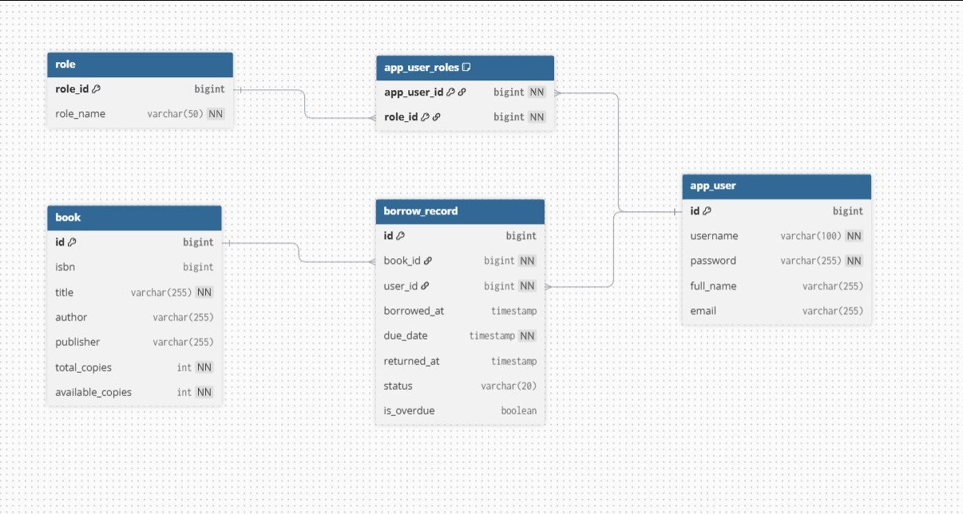
Database Design
+ Relationships
- Users ↔ Roles (Many-to-One)
- Users ↔ Borrows (Many-to-Many)
- Books ↔ Borrows (One-to-Many)

Slide 13
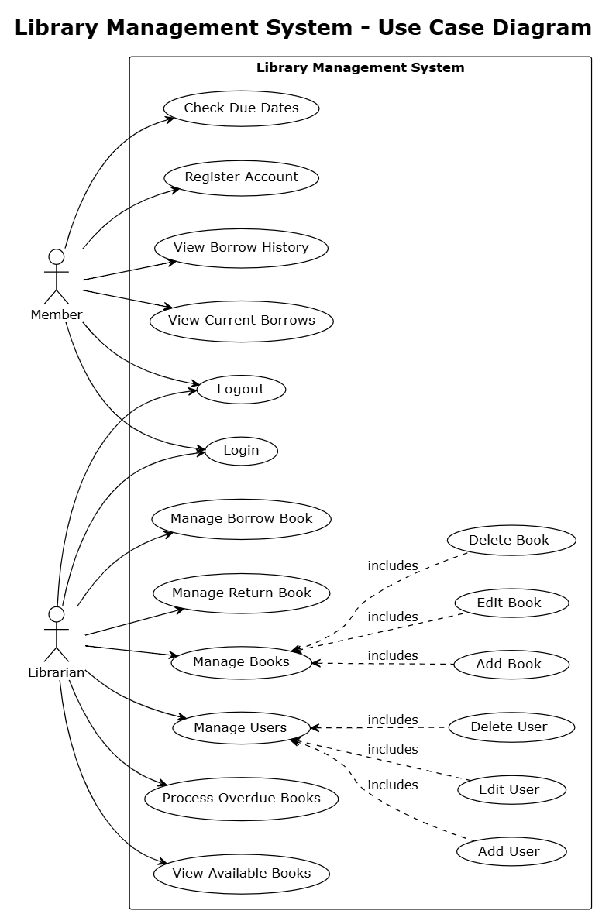
UML Design
Use case diagram

Slide 14
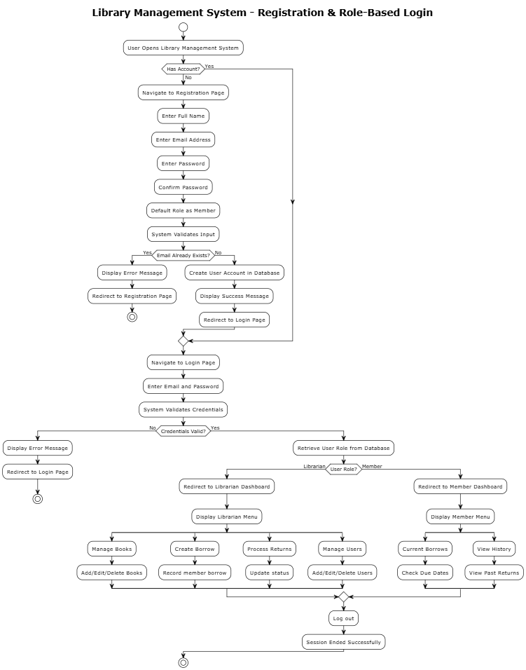
UML Design
LOGIN-REGISTER ACTIVITY DIAGRAM

Slide 15
API Endpoint Design
I. Authentication
Authentication | Authentication
GET | /login
POST | /api/login
GET | /register
POST | /api/register

Slide 16
API Endpoint Design
II. Librarian
Librarian | Librarian
GET | /dashboard

Slide 17
API Endpoint Design
II. Librarian
book management | book management
GET | /admin/book
GET | /admin/book/new
POST | /admin/book/new
GET | /admin/book/edit/{id}
POST | /admin/book/edit/{id}
GET | /admin/book/edit/{id}

Slide 18
API Endpoint Design
II. Librarian
borrow management | borrow management
GET | /admin/borrows
GET | /admin/borrows/new
POST | /admin/borrows/borrow
POST | /admin/borrows/delete/{id}
POST | /admin/borrows/return/{id}

Slide 19
API Endpoint Design
II. Librarian
Users management | Users management
GET | /admin/users
GET | /admin/users/new
POST | /admin/users/save
GET | /admin/users/edit/{id}
GET | /admin/users/delete/{id}

Slide 20
API Endpoint Design
III. Member
Member | Member
GET | /member/home
GET | /member/borrows/current
GET | /member/borrows/history

Slide 21
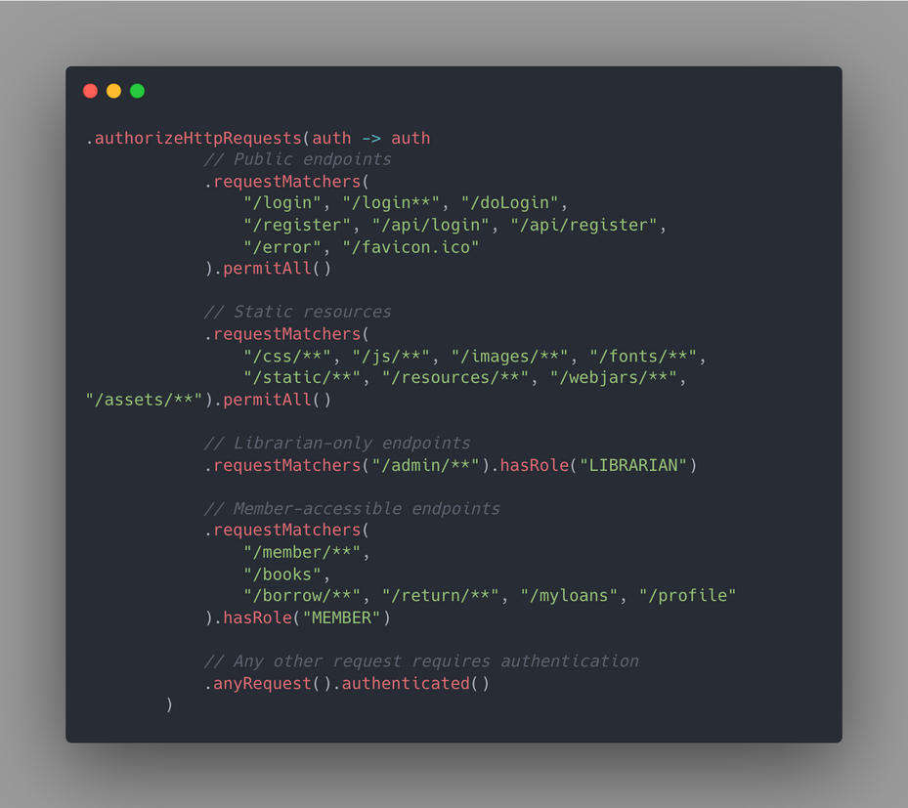

Implementation
ROLE LIBRARIAN can access to page admin all
ROLE MEMBER can access to page member all, book,borrow,return,myloans and profile

Slide 22
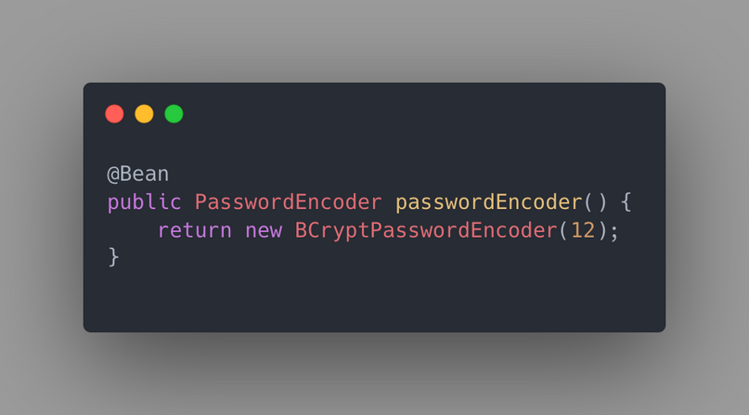
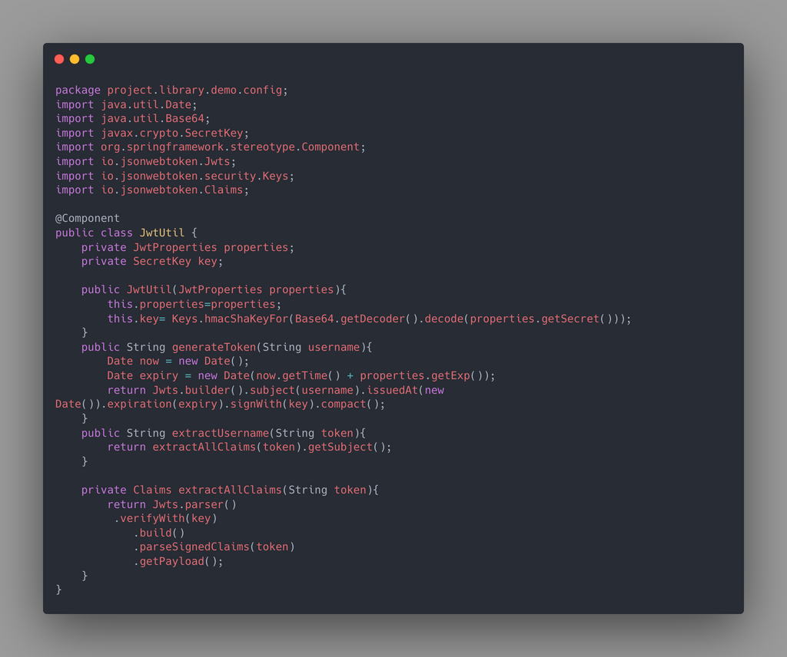
Implementation
Uses BCrypt to hash passwords with strength 12
Generate Token using username

Slide 23
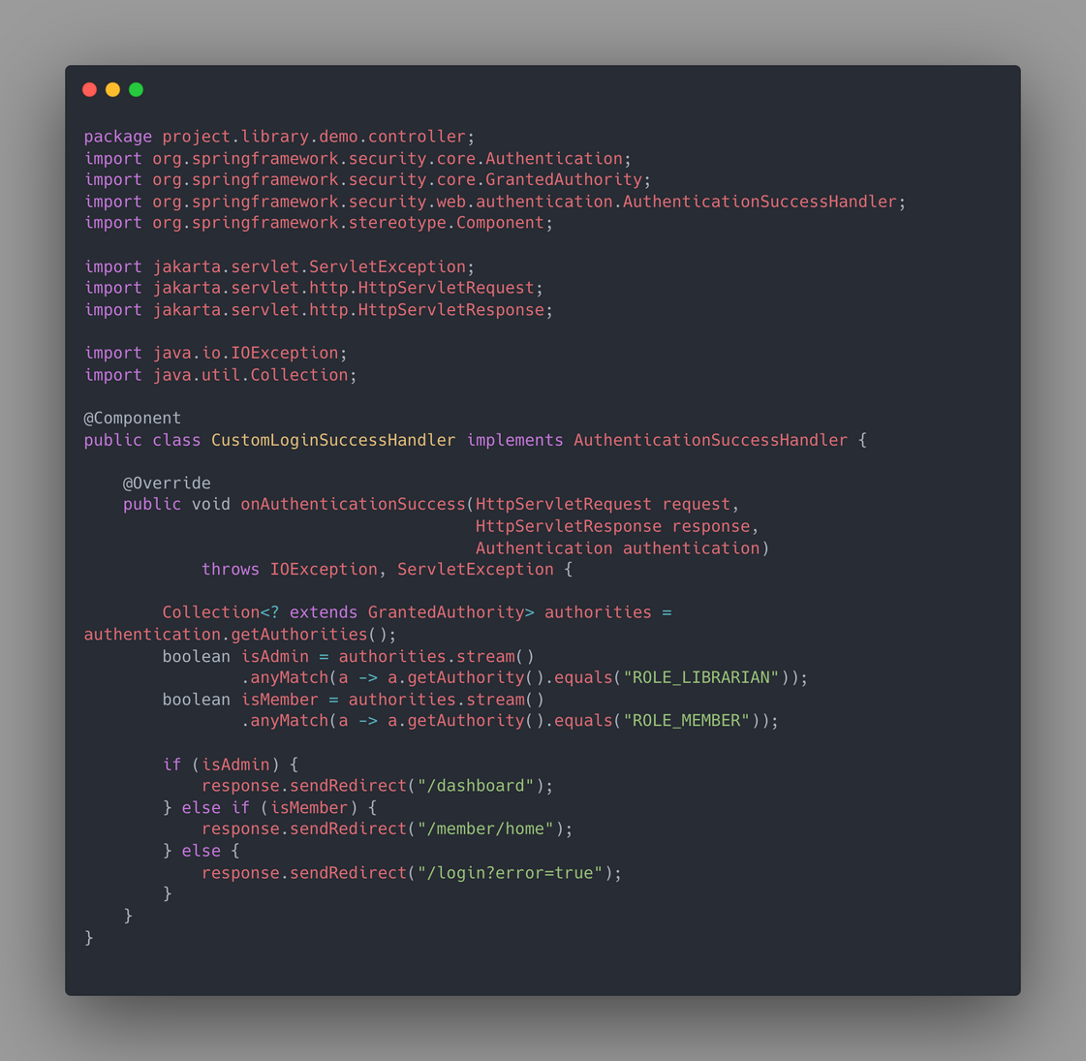
Implementation
This page to control the ROLE:
LIBRARIAN
MEMBER
It role librarian we go page dashboard
It role members we go page /member/home
It not two page is error

Slide 24
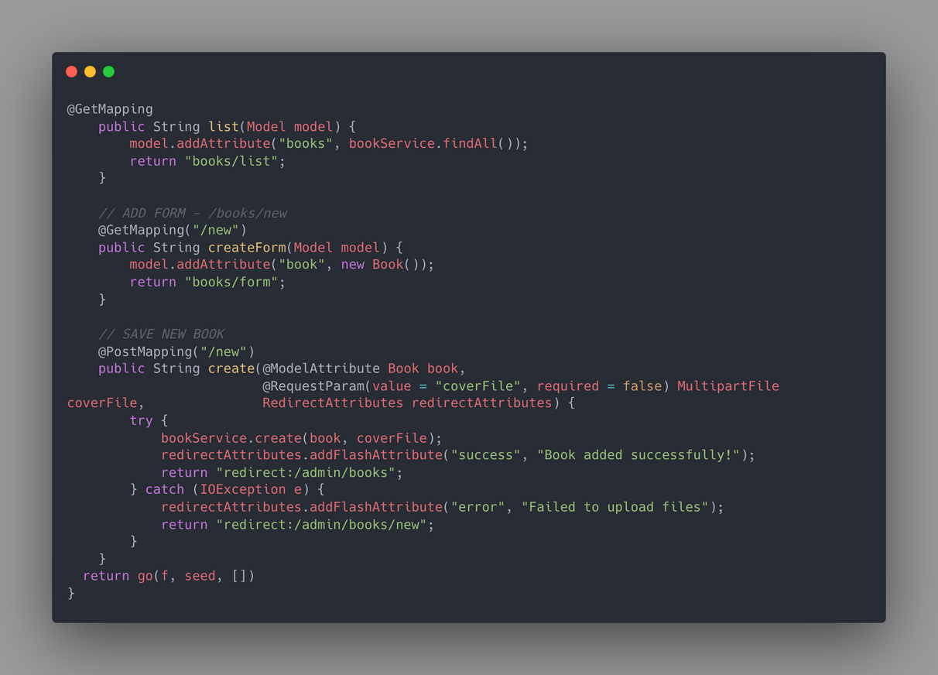
Implementation
This function displays the book list
The function is the form add book
This component is save when we input to form

Slide 25
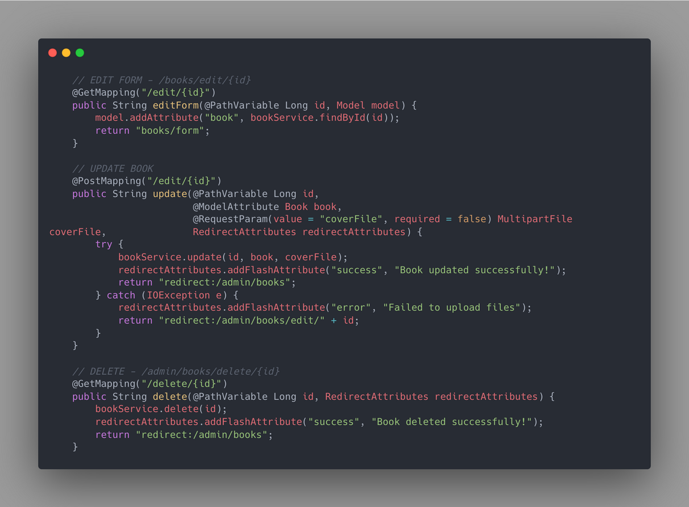
Implementation
This form edit the component book
After input the form this function have save data input
The function have delete the book

Slide 26
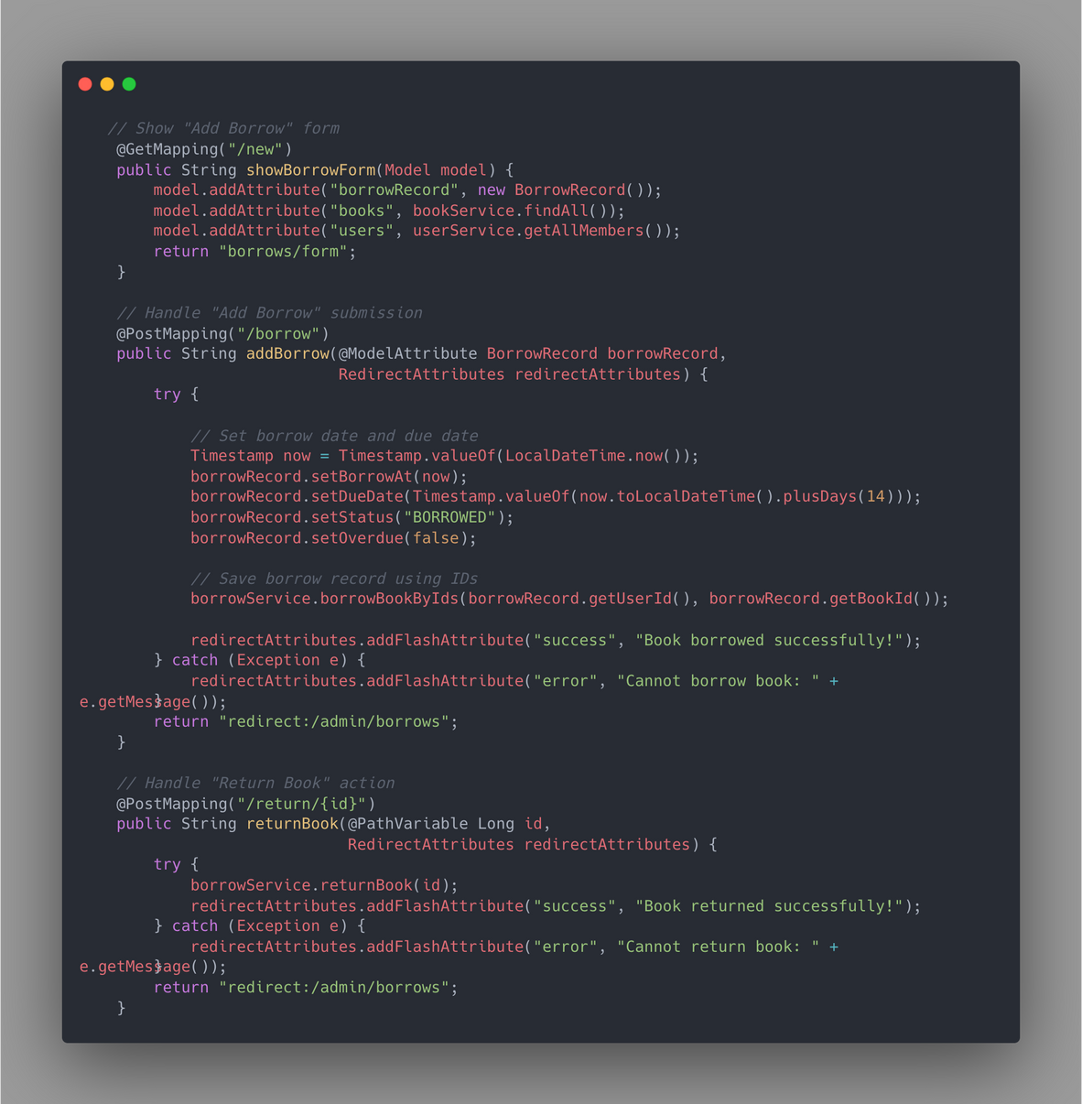
Implementation
This form handle user borrow book
This function handle day when member borrow the current day count to 14 day is Overdue day
The function when book is return

Slide 27
Conclusion
This project is built for librarians and library members to track borrowing records. Librarians can manage members, books, and borrow records, while members can only view their own records. The system helps make library management more organized and efficient.
Difficulties
Security Implementation
Hard to build with Thymeleaf
Conflict code with teammate
Database Design is problem

Slide 28
Conclusion
Future Improvements
More security features
Improves User Experience
Add more feature for member and Librarians
Code quality

Slide 29


THANK YOU!

